Slide 1
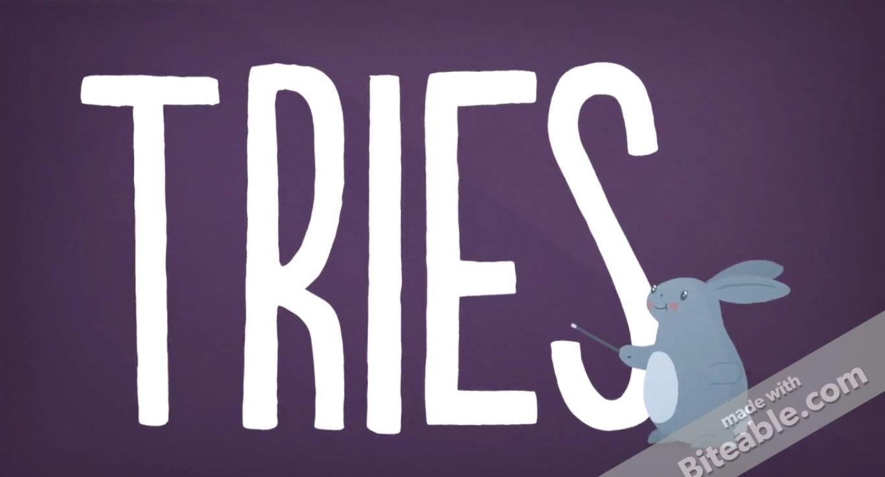
By Rubaiyat Rashid
CSCI 335
Prof. Stamos

Slide 2
The word Trie comes from its use of Retrieval and it is pronounced as “try”
Trie is also known as radix tree or
prefix tree

Slide 3
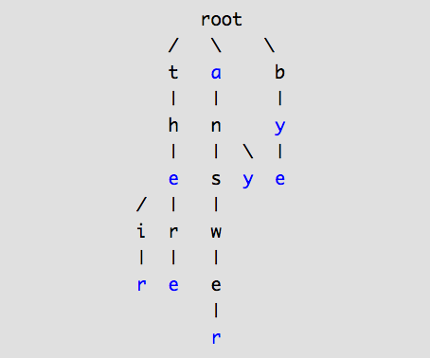
What is a Trie data structure?
Trie is a type of a tree but it is often used to store characters
Each node might store a character
If two string have a common prefix, then they share a ancestor
in this tree
For Example, the words “monolith” and ”monologue” share
the same prefix “mono”
The basic idea is take to take advantage of strings sharing prefixes as opposed to treating each strings as completely different objects

Slide 4
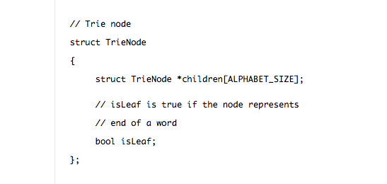
Insert
Example of a Struct TrieNode
We insert a key by searching into the trie
The children of a TrieNode are an array of pointers
We start from root which contains the first key character
Every character of the key is stored as an individual trie node
If the key to be inserted is a new key or an extension of a existing key, a value
field, a boolean, for example, marks the end of that key

Slide 5
Root
Example 1 , Insert (“there”)
t
h
e
r
Note, end of keys are marked with
A boolen
e

Slide 6
Root
Example 2, Insert (“their”)
t
h
e
r
i
e
r

Slide 7
Complexity Analysis for insert
Time Complexity : O(m), where m is the key length
In each iteration of the algorithm, we either examine or create a node in the trie tree until we reach the end of the key
Worst case for a English word in the dictionary (if inserted first) “Pneumonoultramicroscopicsilicovolcanoconiosis” (forty-five letters)

Slide 8
Search
Searching is similar to to insert operation, however we only compare the characters
and move down.
Two Cases:
A link exists. Move to the next node to search for the next key character
A link does not exist. If there are no more characters to search for and
current node is marked as the end of the key, return true. Otherwise, return false

Slide 9
Root
Insert (“CARS”)
Insert (”TRY”)
Insert (“CAT”)
Insert (“CARDS”)
Insert (“DOGS”)
C
T
D
A
R
O
Example 1, search (“CAT”)
R
T
Y
G
Returns True
D
s
S
S

Slide 10
Root
Insert (“CARS”)
Insert (”TRY”)
Insert (“CAT”)
Insert (“CARDS”)
Insert (“DOGS”)
C
T
D
Example 2, search (“CAP”)
A
R
O
R
T
Y
G
Returns False
Because ‘R’ does not exist
In this level
s
D
S
S

Slide 11
Complexity Analysis for search
Time Complexity : O(m), where m is the key length
In the worst case, m characters of the key is searched

Slide 12
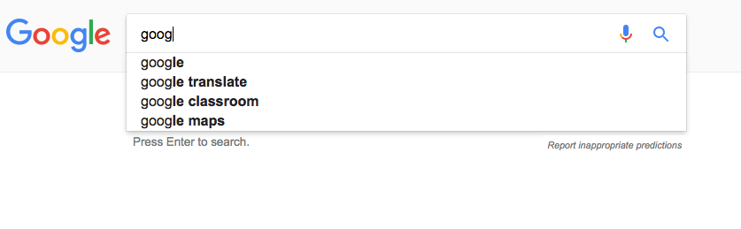
Applications
Autocomplete

Slide 13
Applications
2. Spellchecker

Slide 14
Why should you learn tries?
It is a very common interview question
Better search time than Binary Search Tree & AVL
Looking up data in a trie is also faster, O(m) in the worst
case, compared to an imperfect hash table in which
the worst case of search would be O(N)

Slide 15
How do you choose between a hashtable
and Trie?
If you only need to do insertion and search, use a hashtable
If you want to do more complex operations such as prefix-related search, then a trie might be a better solution
Trie can also be structured to work with Suffixes as well

Slide 16
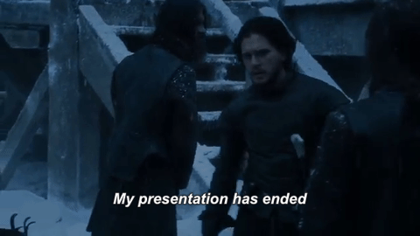
Fín

Slide 17
Sources
https://www.topcoder.com/community/data-science/data-science-tutorials/using-tries/
https://leetcode.com/articles/implement-trie-prefix-tree/
http://www.geeksforgeeks.org/trie-insert-and-search/
http://cdn.makeuseof.com/wp-content/uploads/2014/07/word-2013-inline-spell-check-with-red-squiggly-lines.png?x58476
https://www.youtube.com/watch?v=AXjmTQ8LEoI&t=301s
https://www.grammarly.com/blog/14-of-the-longest-words-in-english/

